Slide 1
Graphic Formats
2.01 Investigate graphic image design.
Notes:
1.01 Investigate graphic types and file formats.

Slide 2
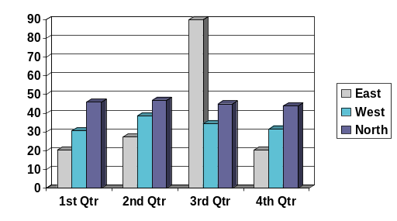
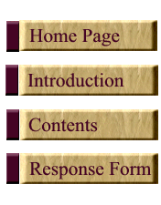
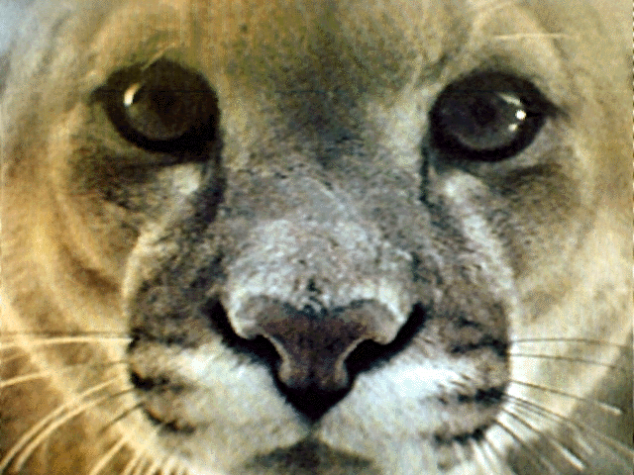
Graphics
Graphics - anything on the page that is not actual text, from simple line drawings to fully active images found on the World Wide Web.
There are many different graphic file formats.
The format you choose depends on several factors.
Buttons
Photograph
Chart
Notes:
1.01 Investigate graphic types and file formats.

Slide 3
Factors that Affect Graphic
Format
Color depth
Compression
Portability
Transparency
Notes:
1.01 Investigate graphic types and file formats.

Slide 4
Color Depth
The number of colors per pixel that can be contained in an image.
Most graphics editing programs will allow you to set the color depth for your image.
Different graphic formats contain different numbers of colors per pixel.
Examples:
1-bit Color | 2 Colors Per Pixel
8-bit Color | 256 Colors Per Pixel
16-bit Color | 65.5 Thousand Colors Per Pixel
24-bit Color | 16.7 Million Colors Per Pixel
Notes:
Teachers: Color Depth here refers to the number of colors that can be contained in the image. It is not referring to the number of colors which can be displayed on a computer monitor.
Just for Fun (supplemental, not required): If you would like to integrate math into your curriculum, you could have students calculate the number of colors which can be displayed in an image based on the bits of color. To calculate this, raise 2 to the power of the color resolution. (Because each bit can contain 2 pieces of data: 1 or 0). So 8-bit color = 2^8 = 256 color possibilities per pixel.
1-bit color = 2¹ = 2 colors
8-bit color = 2⁸ – 256 colors
16-bit color – 2¹⁶ = 65.5 thousand colors
1.01 Investigate graphic types and file formats.

Slide 5
Compression
Compression refers to how an image is saved in order to reduce the file size.
The greater the compression, the lower the quality
Two types:
  Lossless
    Reduces the file size without losing any pixel data
    Quality is not compromised
  Lossy
    Alters and/or eliminates some data
    The more the image is reduced, the more the quality is degraded
Notes:
Teacher Note: Lossy compression deletes some of the data that it deems unnecessary since the human eye is not very sensitive to changes in color over small distances.
1.01 Investigate graphic types and file formats.

Slide 6
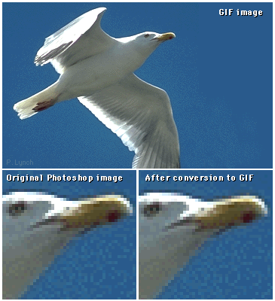
Lossless Compression
Before Compression
After Compression
Notice that there is no difference, no data has been lost.
Notes:
Teacher Note: Lossless compression looks for recurring patterns and replaces each occurrence with an abbreviation. If there isn’t a lot of redundant information, then the file size may not be decreased very much.
Lossless compression is used when it is important for the compressed image to look exactly like the original image.
1.01 Investigate graphic types and file formats.

Slide 7



Lossy Compression
Notice that each time the image is saved, the quality is degraded.
In the third image, the image is very pixelated.
Original . . . . . .
Final compression
Notes:
Teacher Note: In lossy compression, the more times you save the image, the more data that is eliminated and the more the quality of the image is degraded. So every time you save a JPG file, the quality is degraded more.
To prevent this, make all of the editing changes in the editing software program’s native format or in a bitmap format before saving the final image as a JPG or other compressed format which uses lossy compression.
1.01 Investigate graphic types and file formats.

Slide 8
Portability
How easily you can open, modify, and view the files on computers using different operating systems, software and browsers.
Notes:
1.01 Investigate graphic types and file formats.

Slide 9
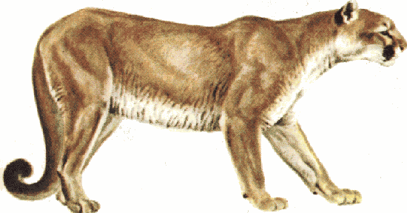
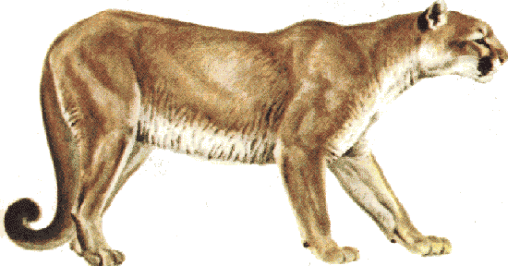
Transparency
Allows the background color of an image to be “eliminated” or made transparent so that the background behind the image can be seen.
It makes part of the image invisible, or “see-through.”
Notes:
Teacher Note: To illustrate this concept, hold up a photograph on a piece of paper and hold a piece of colored paper behind it. You cannot see the color through the image. Next, hold up a transparency with a piece of colored paper behind it. The background color does change.
1.01 Investigate graphic types and file formats.

Slide 10
Factors to Consider When Choosing a Graphic File Format
Which file format is best for a particular application?
How important is the quality of the image when transferred, copied, or displayed?
How important is the speed at which the image transfers or loads?
How important is file size?
Notes:
Teacher Note: The answers to these questions will help determine which graphic file type should be used.
1.01 Investigate graphic types and file formats.

